Slide 1
Cookbook for Practice 10.4
实践10.4攻略
Cong Li 李聪

Slide 2


Kernel 核计算
Create a new file ‘kernels.py’, import ‘numpy’, & create a new class ‘PolynomialKernel’. In its initialization function, accept a degree parameter & store it in a member variable
创建新文件“kernels.py”，导入“numpy”，创建一个新类型“PolynomialKernel”，在初始化函数中接受一个度数参数，并存于成员变量中
Write another member function for kernel calculation
另写一个成员函数进行核计算

Slide 3

Kernel Perceptron
核计算感知器 (1)
In ‘perceptron.py’, create a new class ‘BinaryKernelPerceptron’. In its initialization function, accept 3 parameters, the kernel, the maximum number of training iterations, & the margin
在“perceptron.py”中，创建新类型“BinaryKernelPerceptron”。在初始化函数中接受3个参数，核计算、最大训练轮数和间距。

Slide 4
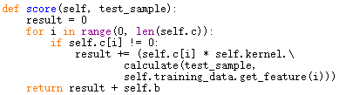
Kernel Perceptron
核计算感知器 (2)
Write the scoring member function, assuming that the update history & bias are properly maintained, as well as the training data stored in a member function
假设我们正确地维护了更新历史和偏向，并把训练数据记录在一个成员变量中，写一个计算得分的成员函数
Here we merge $c^{(i)}y^{(i)}$ into c[i]

Slide 5

Kernel Perceptron
核计算感知器 (3)
Then the classification function 然后是分类函数

Slide 6
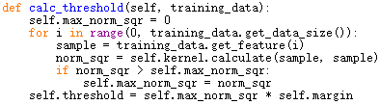
Kernel Perceptron
核计算感知器 (4)
We also need to rewrite the way that we calculate the maximum norm & the confidence threshold used in training w/ the kernel
我们还要重写用核计算来计算训练中所要用到的最大长度和置信度阈值

Slide 7


Kernel Perceptron
核计算感知器 (5)
Finally the training part: first record the training data, initialize the update history & the bias, & calculate the maximum norm & the margin threshold
最后进行训练：先记录下训练数据，初始化更新历史和偏向，并计算最大长度和置信度阈值
Output something every 100 iterations
每训练100轮输出一些信息

Slide 8
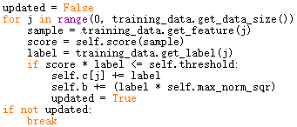
Kernel Perceptron
核计算感知器 (6)
Go through all the training data. When the condition is met, update the bias & record the update history
最遍历所有训练数据。满足条件时更新偏向并记录更新历史

Slide 9

Run It 运行之
Based on Practice 10.2, in ‘test.py’, import ‘kernels’
基于实践10.2，在“test.py”中，导入“kernels”
Create a polynomial kernel instance w/ degree 2 & derive a kernel perceptron from it
创建一个度数为2的多项式核计算实例，并从中导出一个核计算感知器
Run w/ the command line below 用以下命令行运行
test.py 50

Slide 10
The End

